Slide 1
Berbicara dan Bertindak Berdasarkan Data & Fakta yang Benar
WORK HABIT

Slide 2
Berbicara dan Bertindak Berdasarkan Data & Fakta yang Benar
Berbicara, bertindak, dan memutuskan harus
berdasarkan data dan fakta yang benar serta sudah diverifikasi.
Data harus disampaikan dalam bentuk yang
komunikatif , sehingga mudah dipahami Atasan dan orang lain dengan baik. Misal: menunjukkan sampel barang, visualisasi yang baik (grafik, bagan, flowchart, gambar/ skets, diberi warna berbeda, dsb), sistematis,poin-poin yang jelas, ada pengelompokan, dll.

Slide 3
DASAR PEMIKIRAN
01
Data dan fakta yang benar akan menghindari asumsi, opini, salah paham, yang dapat mengakibatkan
kesalahan pengambilan keputusan dan pemborosan.
02
Bila perlu lakukan “Genba-Genchi-Genbutsu”
(melihat fakta di lapangan dengan mata kepala sendiri)
guna lebih memahami masalahnya.
03
Tanpa data dan fakta yang benar, maka diskusi dapat berlangsung bertele-tele, debat kusir,
menimbulkan konflik, dan tidak akan mendapatkan 'root cause' sebenarnya guna menetapkan
'corrective action' yang tepat.

Slide 4
DASAR PEMIKIRAN
Data dan fakta yang benar akan menghindari asumsi, opini, salah paham, yang dapat mengakibatkan
kesalahan pengambilan keputusan dan pemborosan.
Neptune
02
Neptune is fake
Saturn
03
Saturn isnothing

Slide 5
Online learning planner infographics
Earth
Mercury
01
Earth is the third planet from the Sun
Planet Mercury is the closest object to the Sun
04
Neptune
Mars
02
Neptune is the farthest planet from the Sun
Despite being red, Mars is a cold place
05
Saturn
Jupiter
03
Saturn is composed of hydrogen and helium
Jupiter is a gas giant and the biggest planet
06

Slide 6
Online learning planner infographics
Earth
Neptune
Saturn
Mars
Mercury
Earth is the third planet from the Sun
Neptune is the farthest planet from the Sun
It’s composed of hydrogen and helium
Despite being red, Mars is a cold place
Mercury is the closest object to the Sun

Slide 7
Online learning planner infographics
Neptune
Mars
Neptune is the farthest planet from the Sun
Despite being red, Mars is a cold place
Earth
Saturn
Mercury
Earth is the third planet from the Sun
It’s composed of hydrogen and helium
Mercury is the closest object to the Sun

Slide 8
Online learning planner infographics
Earth
Mercury
Earth is the third planet from the Sun
Planet Mercury is the closest object to the Sun
Neptune
Mars
Neptune is the farthest planet from the Sun
Despite being red, Mars is a cold place
Saturn
Jupiter
Saturn is composed of hydrogen and helium
Jupiter is a gas giant and the biggest planet

Slide 9
Online learning planner infographics
Earth
Earth is the third planet from the Sun
70%
Neptune
Neptune is the farthest planet from the Sun
60%
Saturn
Saturn is composed of hydrogen and helium
50%

Slide 10
Online learning planner infographics
Jupiter
Jupiter is a gas giant and the biggest planet
97K
Earth
Earth is the third planet from the Sun
74K
Neptune
62K
Neptune is the farthest planet from the Sun
Saturn
34K
Saturn is composed of hydrogen and helium

Slide 11
Online learning planner infographics
01
03
Earth
Mercury
It’s the third planet from the Sun
Mercury is the closest object to the Sun
02
04
Neptune
Mars
Neptune is the farthest planet from the Sun
Despite being red, Mars is a cold place

Slide 12
Online learning planner infographics
85%
75%
Mercury
Earth
It’s the closest object to the Sun
Earth is the third planet from the Sun
45%
65%
Jupiter
Mars
It’s a gas giant and the biggest planet
Planet Mars is a very cold place, not hot

Slide 13
Online learning planner infographics
TIME | SUN | MON | TUE | WED | THU | FRI | SAT
9:00 | Project | Class | Read | Conference | History | Review | Project
10:00 | Science | Exam | Maths | Conference | Activities | Science | Study
11:00 | Geography | Maths | Science | History | Study | Conference | Conference
12:00 | Geography | History | Meeting | Science | Exam | Conference | Trip
13:00 | Break | Lunch | Activities | Lunch | Exam | Drawing | Trip
14:00 | Lunch | Coffee | Exam | Project | Lunch | Lunch | Lunch

Slide 14
Online learning planner infographics
42K
54K
Jupiter
Mercury
A gas giant and the biggest planet
Mercury is the closest object to the Sun
64K
76K
Saturn
Neptune
It’s the closest object to the Sun
It’s the farthest planet from the Sun

Slide 15
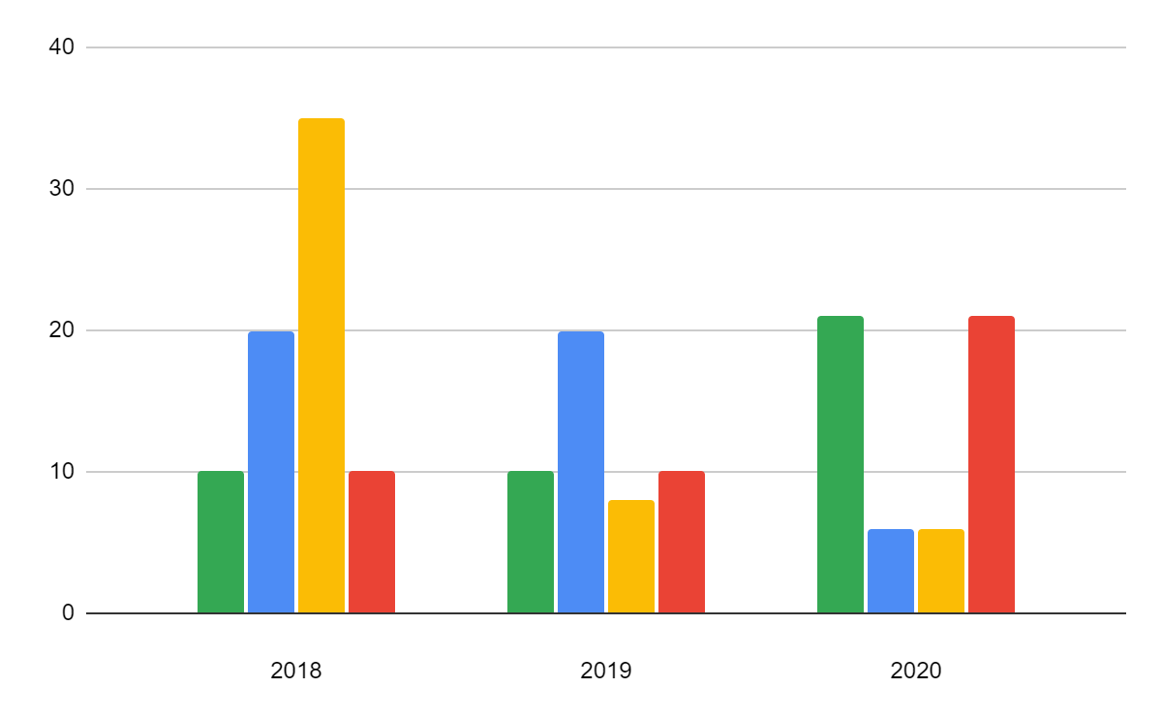
Online learning planner infographics
Saturn
Saturn is composed of hydrogen and helium
Mars
Despite being red, Mars is a cold place
Mercury
Planet Mercury is the closest object to the Sun
Jupiter
If you want to modify this graph, click on it, follow the link, change the data and replace it
Jupiter is a gas giant and the biggest planet

Slide 16
Online learning planner infographics
60%
Mars
30%
Mercury
Despite being red, planet Mars is a very cold place
Mercury is the closest planet to the Sun and the smallest one

Slide 17
Online learning planner infographics
Mercury
Mercury is the closest object to the Sun
Saturn
It’s composed of hydrogen and helium
Mars
Despite being red, Mars is a cold place
Neptune
It’s the farthest planet from the Sun

Slide 18
Online learning planner infographics
01
03
Mercury
Saturn
It’s the closest planet to the Sun and the smallest
It is composed of hydrogen and helium
02
04
Jupiter
Mars
It’s a gas giant in the Solar System
Planet Mars is a very cold place

Slide 19
Online learning planner infographics
 | SUNDAY | MONDAY | TUESDAY | WEDNESDAY | THURSDAY | FRIDAY | SATURDAY
TEAM WORK | Day off | Project | Project | Study | Study | Exam | Day off
WEEK 2 | Day off | Study | Study | Meeting | Meeting | Project | Day off
WEEK 3 | Meeting | Meeting | Project | Study | Study | Project | Day off
WEEK 4 | Study | Study | Meeting | Exam | Project | Project | Day off
WEEK 5 | Project | Project | Meeting | Meeting | Trip | Trip | Trip

Slide 20
Online learning planner infographics
Neptune
Neptune is the farthest planet from the Sun
10k
Mars
Despite being red, Mars is a cold place
25k
Saturn
It is composed of hydrogen and helium
30k

Slide 21
Online learning planner infographics
 | Task | Priority
 | Write here your task
 | Write here your task
 | Write here your task
 | Write here your task
 | Write here your task
 | Write here your task

Slide 22
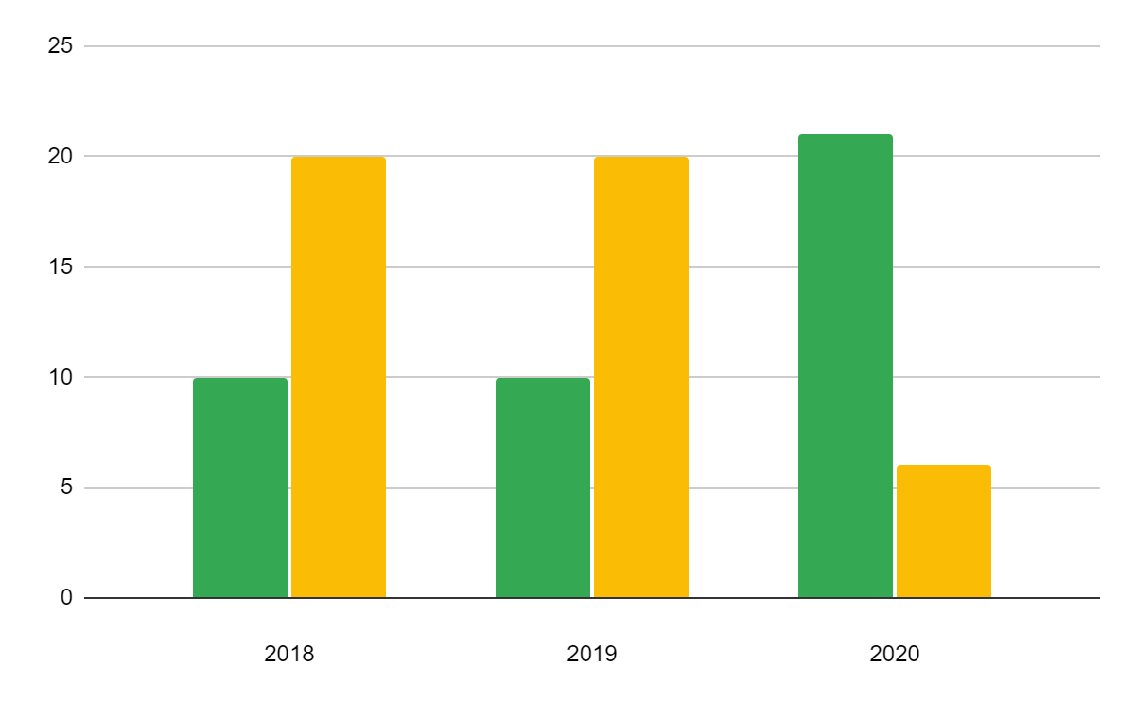
Online learning planner infographics
47K
42K
Saturn
Neptune
It’s the closest object to the Sun
It’s the farthest planet from the Sun
If you want to modify this graph, click on it, follow the link, change the data and replace it

Slide 23
Online learning planner infographics
TRACKER
Study math
Meeting
Project
01
02
03
04
05
06
07
08
09
10
11
12
13
14
15
16
17
18
19
20
21
22
23
24
25
26
27
28
29
30
31
Study math
Meeting
Project
Here you can write how to develop this task
Here you can write how to develop this task
Here you can write how to develop this task

Slide 24
Online learning planner infographics
CHECKLIST
Write your checklist
Write your checklist
Write your checklist
Write your checklist
Write your checklist
Write your checklist
NOTES
Write your own notes
Write your own notes
Write your own notes
Write your own notes
Write your own notes
Write your own notes

Slide 25
Online learning planner infographics
Mars
10K
Despite being red, planet Mars is a very cold place
Saturn
10K
It is composed of hydrogen and helium gas
Jupiter
10K
It’s the biggest object in the Solar System
Mercury
10K
It’s the closest planet to the Sun and the smallest one

Slide 26
Online learning planner infographics
Earth
Mercury
Earth is the third planet from the Sun
It’s the closest object to the Sun
01
02
03
04
05
Neptune
Saturn
Mars
It’s the farthest planet from the Sun
It’s composed of hydrogen and helium
Despite being red, Mars is a cold place

Slide 27
Online learning planner infographics
Activities | Check
Write your activity
Write your activity
Write your activity
Write your activity
Write your activity
Write your activity
Write your activity
To do
Write your notes
Write your notes

Slide 28
Online learning planner infographics
GOALS | MO | TU | WE | TH | FR
Paint
Eat healthier
Project
Writer
NOTES
Write your own notes
Write your own notes
Write your own notes
Write your own notes
Write your own notes
Write your own notes

Slide 29
Online learning planner infographics
Part | Description | Check
Exam | Here you can write a brief description
Project | Here you can write a brief description
Exam | Here you can write a brief description
Project | Here you can write a brief description
Exam | Here you can write a brief description
Project | Here you can write a brief description

Slide 30
Online learning planner infographics
1
2
3
4
25k
50k
75k
8k
Earth
Mercury
Neptune
Saturn
The Earth is the third planet from the Sun
Planet Mercury is the closest object to the Sun
Neptune is the farthest planet from the Sun
It’s composed of hydrogen and helium gas

Slide 31
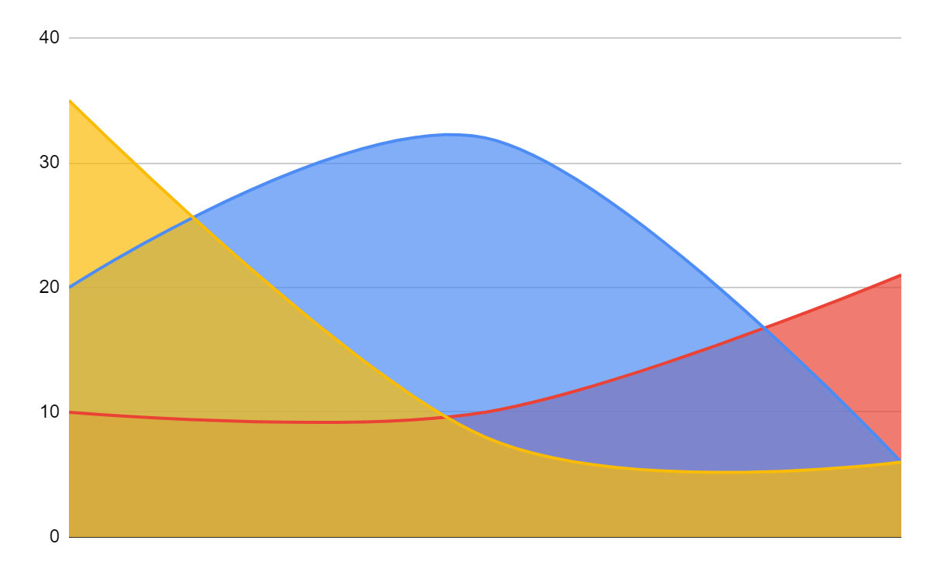
Online learning planner infographics
Earth
Earth is the third planet from the Sun
Neptune
Neptune is the farthest planet from the Sun
Saturn
Saturn is composed of hydrogen and helium
If you want to modify this graph, click on it, follow the link, change the data and replace it

Slide 32
Online learning planner infographics
01
02
03
Neptune
Mars
Earth
It’s the farthest planet from the Sun
Despite being red, Mars is a cold place
Earth is the third planet from the Sun

Slide 33
Instructions for use (premium users)
In order to use this template, you must be a Premium user on Slidesgo.
You are allowed to:
Modify this template.
Use it for both personal and commercial purposes.
Hide or delete the “Thanks” slide and the mention to Slidesgo in the credits.
Share this template in an editable format with people who are not part of your team.
You are not allowed to:
Sublicense, sell or rent this Slidesgo Template (or a modified version of this Slidesgo Template).
Distribute this Slidesgo Template (or a modified version of this Slidesgo Template) or include it in a database or in any other product or service that offers downloadable images, icons or presentations that may be subject to distribution or resale.
Use any of the elements that are part of this Slidesgo Template in an isolated and separated way from this Template.
Register any of the elements that are part of this template as a trademark or logo, or register it as a work in an intellectual property registry or similar.
For more information about editing slides, please read our FAQs or visit Slidesgo School:
https://slidesgo.com/faqs and https://slidesgo.com/slidesgo-school

Slide 34
Premium infographics...
Text 1
Text 2
Text 3
Add the Title here
2016
2017
2018
2019
2020
Text 4
Text 5
Text 6
“Mercury is closest planet to the Sun and the smallest”
“Despite being red, Mars is a cold place full of iron oxide”
“Venus has a beautiful name and is the second planet”
“Neptune is the farthest-known planet from the Sun”
“Saturn is a gas giant and has several rings”

Slide 35
Premium infographics...
75%
“Mercury is closest planet to the Sun and the smallest”
75%
“Mercury is closest planet to the Sun and the smallest”
TITLE 1
“Mercury is closest planet to the Sun and the smallest”
“Mercury is closest planet to the Sun and the smallest”

Slide 36
Premium Icons

Slide 37
Premium Icons

Slide 38
Premium Icons

Slide 39
Premium Icons

Slide 40
Premium Icons

Slide 41
Infographics
You can add and edit some infographics to your presentation to present your data in a visual way.
Choose your favourite infographic and insert it in your presentation using Ctrl C + Ctrl V or Cmd C + Cmd V in Mac.
Select one of the parts and ungroup it by right-clicking and choosing “Ungroup”.
Change the color by clicking on the paint bucket.
Then resize the element by clicking and dragging one of the square-shaped points of its bounding box (the cursor should look like a double-headed arrow). Remember to hold Shift while dragging to keep the proportions.
Group the elements again by selecting them, right-clicking and choosing “Group”.
Repeat the steps above with the other parts and when you’re done editing, copy the end result and paste it into your presentation.
Remember to choose the “Keep source formatting” option so that it keeps the design. For more info, please visit Slidesgo School.

